Slide 1
Thermal modification of bottomonium spectral functions from QCD sum rules with the maximum entropy method
Kei Suzuki (Tokyo Institute of Technology)
Philipp Gubler (RIKEN)
Kenji Morita (YITP)
Makoto Oka (TITech, KEK)
P. Gubler, K. Morita, and M. Oka, Phys. Rev. Lett. 107, 092003 (2011)
K. Suzuki, P. Gubler, K. Morita, and M. Oka, arxiv:1204.1173 [hep-th]

Slide 2
Outline of Our Work
・Background
Quarkonium melts in quark gluon plasma (QGP)
ー
・Purpose
To investigate melting temperature
・Method
QCD sum rules with MEM

Slide 3
Outline of Today’s Talk
Introduction
1-1. Quarkonium suppression
1-2. Previous work
2. Methods
Results
3-1. Charmonium
3-2. Bottomonium
3-3. Bottomonium excited states
4. Summary
T=?
ー
T=?
ー

Slide 4
1. Introduction

Slide 5
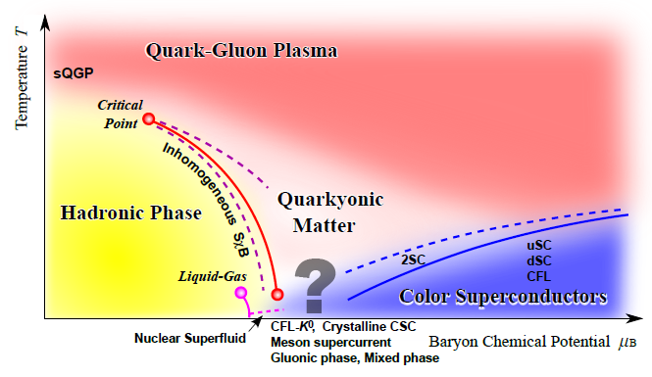
Quarkonium suppression
T. Matsui and H. Satz, Phys. Lett. B178, 416 (1986), T. Hashimoto et al. , Phys. Rev. Lett. 57, 2123 (1986)
Quarkonium suppression
Quarkonium (J/Ψ,Υ etc.) dissociates at finite temperature
⇒Characteristic phenomenon in QGP
ー
Mechanism
―Color Debye scereening
In experiment
―This phenomenon is observed as suppression of quarkonium production
Taken from K. Fukushima and T. Hatsuda,
Rept. Prog. Phys. 74, 014001 (2011)

Slide 6
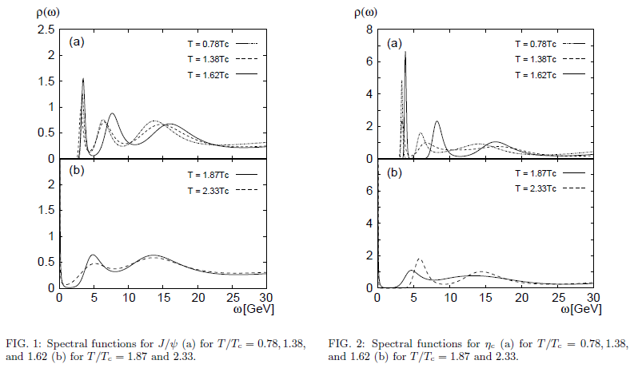
Previous work (Theory)
M. Asakawa and T. Hatsuda,
Phys. Rev. Lett. 92, 012001 (2004)
Lattice QCD with MEM
J/Ψ
J/Ψ
ηc
⇒J/Ψ and ηc melt at 1.6Tc

Slide 7
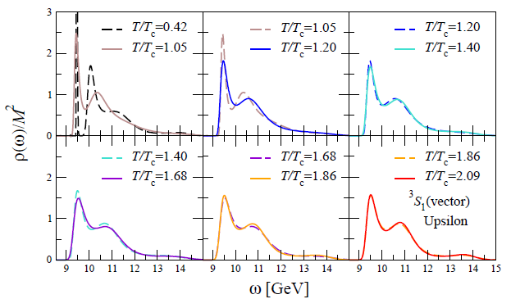
Previous work (Theory)
Lattice QCD + NRQCD with MEM
G. Aarts et al., JHEP 1111 (2011) 103
Υ
⇒Excited state Υ(2S) melts at lower temperature than ground state Υ(1S)

Slide 8
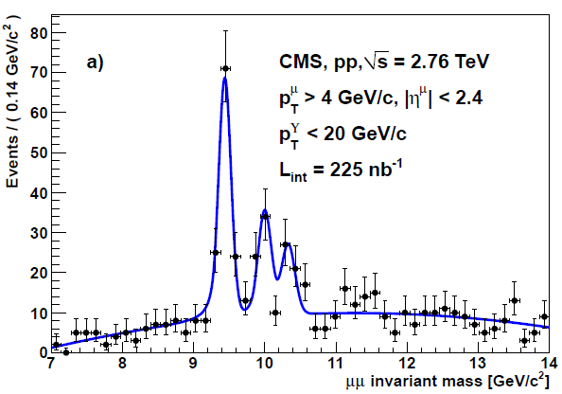
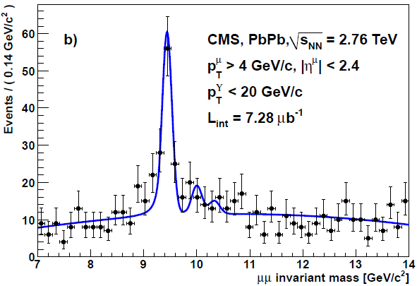
Previous work (Experiment)
S. Chatrchyan et al. [CMS Collaboration], Phys. Rev. Lett.107, 052302 (2011)
Heavy ion collision at the LHC (CERN)
Υ(1S)
Υ(2S,3S)
⇒Excited states Υ(2S), Υ(3S) melt at lower temperature than ground state Υ(1S)

Slide 9
2. Methods

Slide 10
Theoretical approach for quarkonium suppression
How can we describe quarkonium suppression from QCD?
⇒We study temperature dependence of spectral function
Quarkonium correlation function
Spectral function of hadron state
Non-perturbative
QCD approach
latticeQCD, QCD sum rule etc.
T-dependence output
T-dependence input
ρ(t)
ρ(t)
m
t
t

Slide 11
QCD sum rule
M.A. Shifman, A.I. Vainshtein, and V.I. Zakharov,
Nucl. Phys. B147, 385 (1979); B147, 448 (1979)
QCD sum rule
―treats non-perturbative information of QCD
―relates correlation function given from operator product expansion (OPE) to spectral function of hadron
ρ(t)
Borel transformation
m
t
Input OPE
Output spectral function with MEM
One hadron state

Slide 12
OPE
A. Bertlmann, Nucl. Phys. B204, 387 (1982）
temperature dependence
・1st term → Free massive correlator
・2nd term → αs correction
・3rd term → Scalar gluon condensate
・4th term → Twist-2 gluon condensate
perturbative
non-perturbative

Slide 13
OPE
＋
＋
＋
＋
＋
＋
・3rd-term＋4th-term (Gluon condensates)
⇒coefficients of gluon condensates are inversely proportional to m⁴

Slide 14
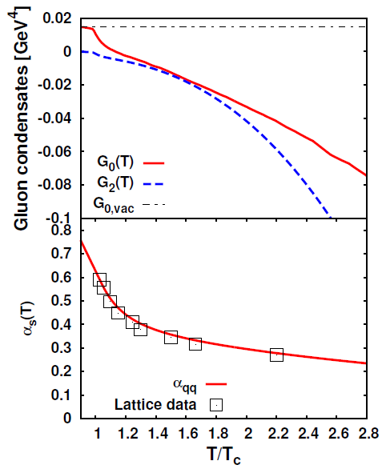
Temperature dependence of gluon condensates
Gluon condensates at finite
temperature are expressed as
energy density ε and pressure p
We Input ε and p from quenched lattice QCD
⇒Gluon condensates decrease
with increasing temperature
K. Morita and S.H. Lee, Phys. Rev. Lett. 100, 022301 (2008); Phys. Rev. C 77, 064904 (2008)

Slide 15
3. Results

Slide 16
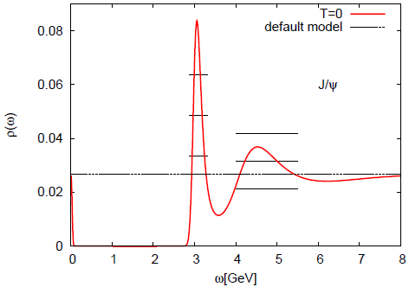
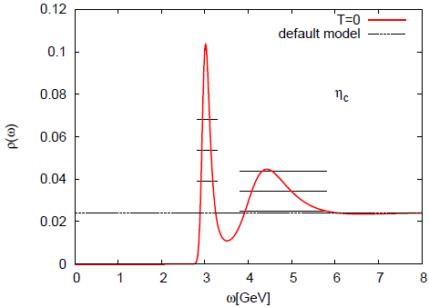
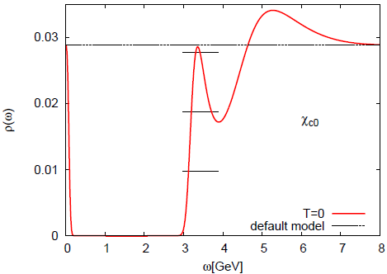
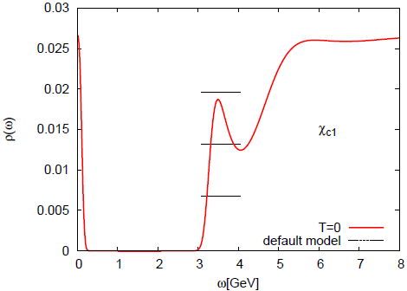
Charmonium at zero temperature
Υ
ηb
J/Ψ
ηc
Mass=3.06GeV exp.)3.10GeV Mass=3.02GeV exp.)2.98GeV
χc0
χc1
Mass=3.36GeV exp.)3.42GeV Mass=3.50GeV exp.)3.51GeV

Slide 17
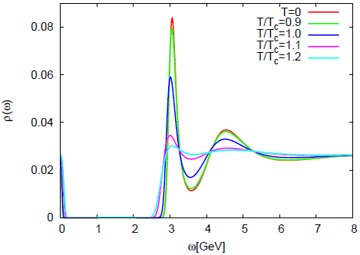
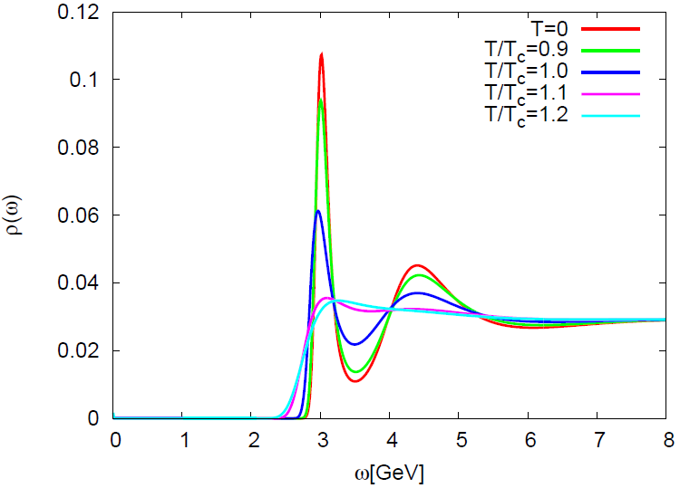
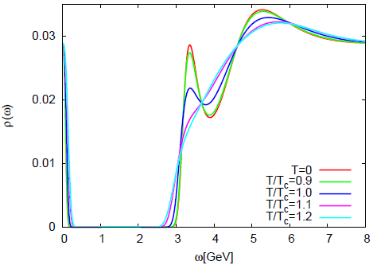
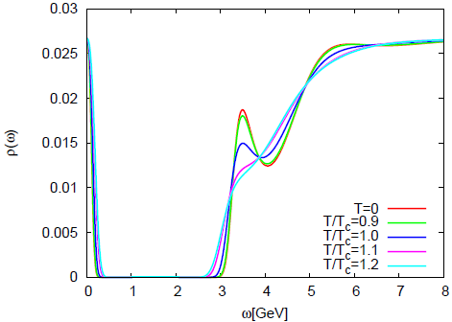
Charmonium at finite temperature
ー
J/Ψ
ηc
disappear at T=1.2Tc disappear at T=1.1-1.2Tc
χc0
χc1
disappear at T=1.0-1.1Tc disappear at T=1.0-1.1Tc

Slide 18
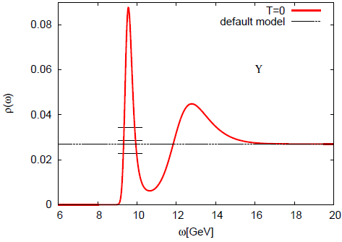
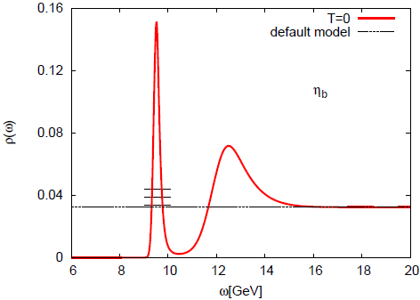
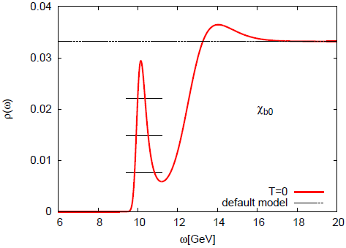
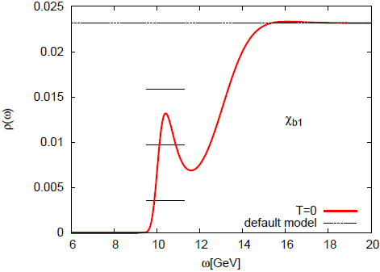
Bottomonium at zero temperature
Υ
ηb
Mass=9.63GeV exp.)9.46GeV Mass=9.55GeV exp.)9.39GeV
χb0
χb1
Mass=10.18GeV exp.)9.86GeV Mass=10.44GeV exp.)9.89GeV

Slide 19
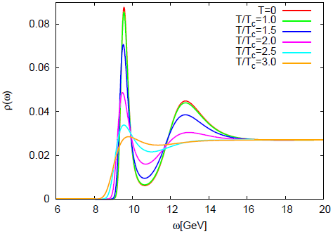
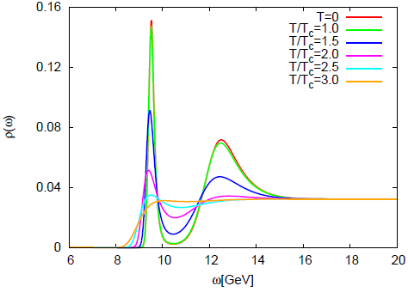
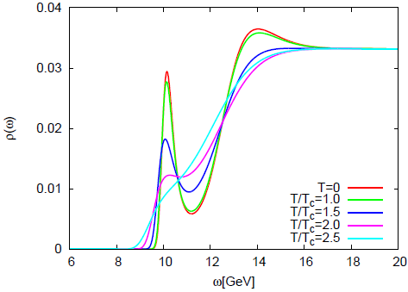
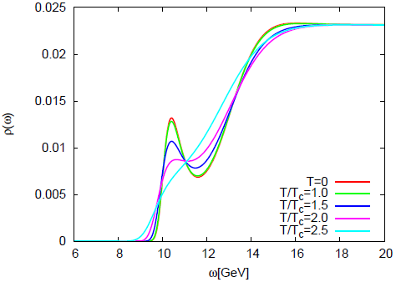
Bottomonium at finite temperature
ー
Υ
ηb
disappear at T>2.5Tc disappear at T>2.5Tc
χb0
χb1
disappear at T=2.0-2.5Tc disappear at T=2.0-2.5Tc

Slide 20
Bottomonium excited states
The obtained bottomonium spectral functions contain contributions of excited states
To investigate behavior of the excited states, we analyzed “residue’’ of peak (integral value of peak)
We used least squares fitting to exclude contributions of continuum
(one peak + continuum as Breit-Wigner + step-like function)
Υ(1S), Υ(2S) and Υ(3S)
Υ
・Our method cannot
separate these states

Slide 21
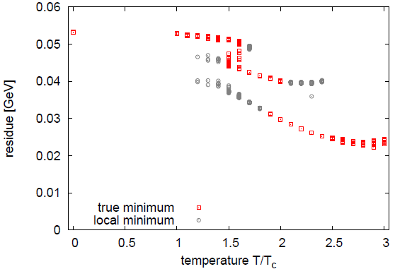
Temperature dependence of residue
Υ(1S+2S+3S)
Υ(1S) only?
Obtained residue of Υ peak decreases with increasing temperature
⇒Excited states(2S, 3S) melt at 1.5-2.0Tc and ground state(1S) survives?

Slide 22
Summary
We extracted melting temperature of quarkonia from QCD sum rules with MEM
Melting temperatures of quarkonia
We suggested that bottomonium excited states Υ(2S,3S) melt at lower temperature than ground state Υ(1S)
J/Ψ | η_{c} | χ_{c0} | χ_{c1}
1.2Tc | 1.1-1.2Tc | 1.0-1.1Tc | 1.0-1.1Tc
Υ | η_{b} | χ_{b0} | χ_{b1}
>2.5Tc | >2.5Tc | 2.0-2.5Tc | 2.0-2.5Tc

